Slide 2
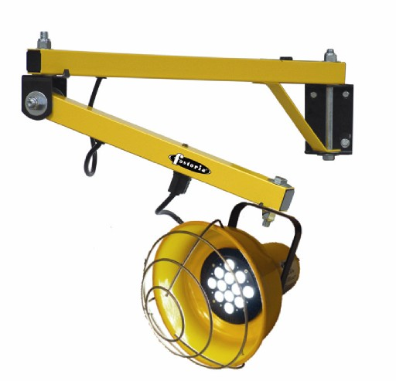
•Available in four different light sources: Incandescent, Quartz Halogen, Fluorescent or LED.
•Two different arm lengths - 40" & 60" (plus 25" Flex arm, incandescent only)
•Fully Assembled - Bolted together and shipped in one Carton.
•Chip resistant safety yellow and black powder coated finish for high visibility and durability.
•1-1/2" square, 14 gauge steel tubing.
•Lamp included with Quartz Halogen, Fluorescent and LED Models (Incandescent models do not include lamp).
•Lamp Guard Included.
•All multi-arm fixtures incorporate a vertical adjust feature allows the dock arm to give when struck by a dock door or tow motor, without breaking the fixture or pulling the light from its mounting.
•40" and 60" models have 300° horizontally and 210° vertically movement . The light heads swivel 300°.
•3" x 5" x 3/16" mounting plate.
•On/Off switch on lighthead.
•5' long 18/3 SJT cordset with NEMA 5-15 grounded plug.
•ETL C/US listed for indoor appilcations only, except QH models are semi-protected outdoor.

Slide 4
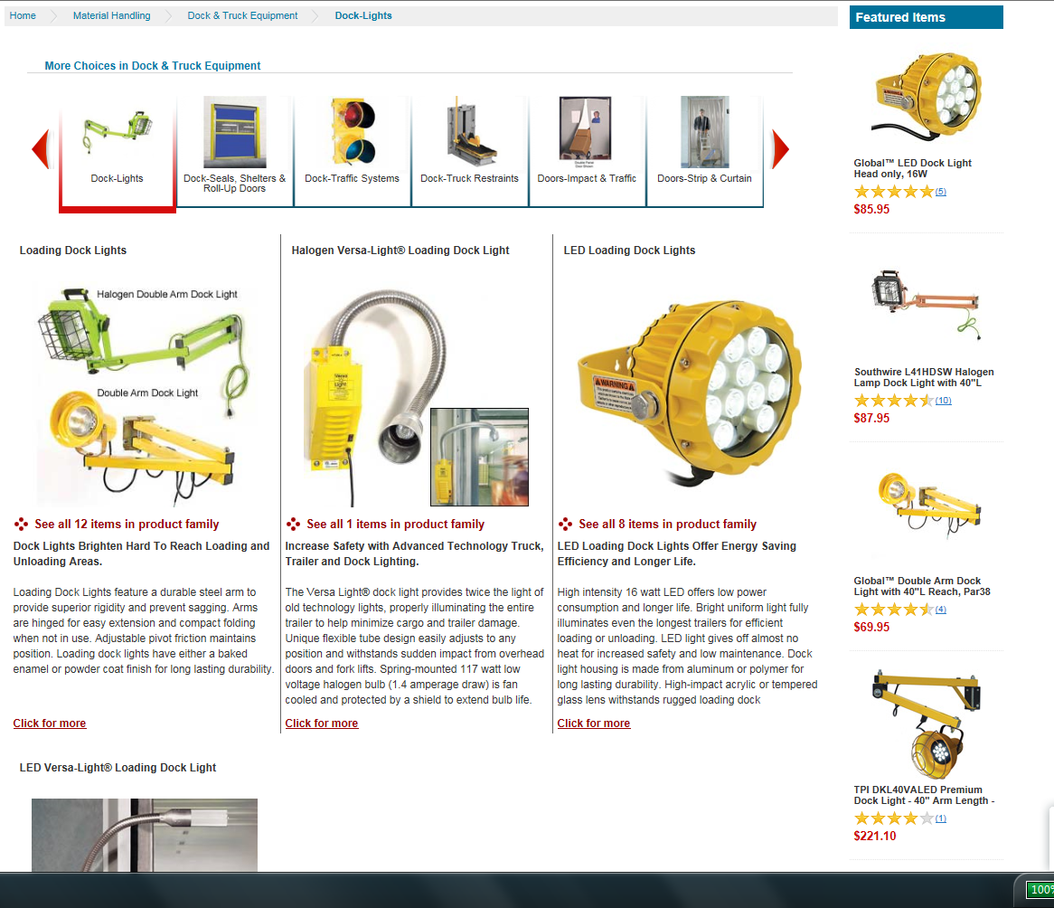

Slide 5
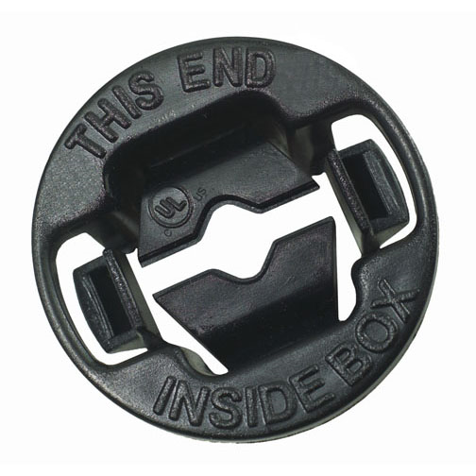
cULus •UL File E195971
Compliances 3 •MSDS
www.hubbell-rtb.com/certifications/Hubbell-RACO_MSDS_for_WP_Boxes_and_Fittings,January_2015.pdf
US Patents •US Patent 7,211,744

Slide 6
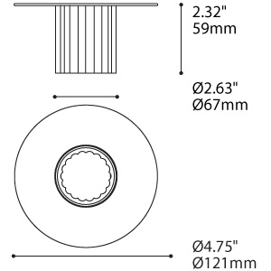
Glass Trim
1181A-S C-FRO
Product Characteristics
Design:
Architectural fixed pinhole trims have a flush lamp, designed for easy installation.
Light Source:
Eureka LED modules or MR16 Lamp types (LED Retrofit, CMH, GZ10 or halogen) available.
Dimming available for all light sources except CMH.
Structure:
Die-stamped and welded 16 GA steel construction with temperature resistant plating
or polyester powder coat finish.
Optic:
LED modules are supplied with Total Internal Reflecting (TIR) Lenses. Tempered glass
diffuser supplied for use with MR16 lamps if required.
DIAMETER 4.75"
ROTATION ANGLE 0°
ADJUSTEMENT ANGLE 0°
CUTTING HOLE 3.50"
STRUCTURE FINISH
BLK | CHR | S C | WH
DIFFUSER FINISH CLR | FRO
CERTIFICATION
LIGHT SOURCE
GZ10.35 35W, HAL, MR16, GZ10 Base
GZ10.50 50W, HAL, MR16, GZ10 Base
MR16.35 35W, HAL, MR16, GU5.3 Base
MR16.50 50W, HAL, MR16, GU5.3 Base
LED.4.30.17 4W, LED 3000K (Warm), 17° (Beam angle)
LED.4.30.48 4W, LED 3000K (Warm), 48° (Beam angle)
LED.8.30.17 8W, LED 3000K (Warm), 17° (Beam angle)
LED.8.30.48 8W, LED 3000K (Warm), 48° (Beam angle)
LED.4.40.17 4W, LED 4000K (Neutral),17° (Beam angle)
LED.4.40.48 4W, LED 4000K (Neutral), 48° (Beam angle)
LED.8.40.17 8W, LED 4000K (Neutral),17° (Beam angle)
LED.8.40.48 8W, LED 4000K (Neutral), 48° (Beam angle)
CMH.MR16.20 20W, CMH, MR16, GX10 Base (ANSI M156)

